Slide 1
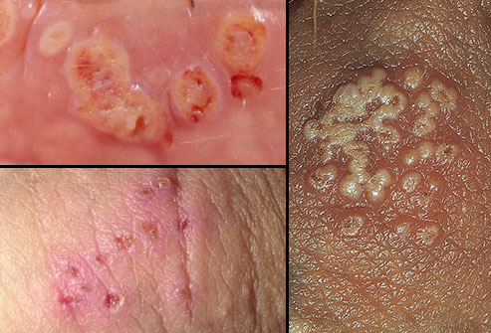

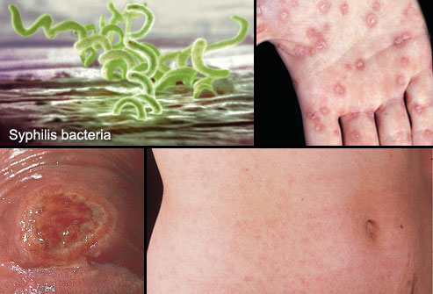

STD Infection in USA
https://www.who.int/images/default-source/imported/adolescents-stis-hiv-kenya.tmb-768v.jpg?Culture=en&sfvrsn=c694ed63_38

Slide 2

Data Source CDC

Slide 3

Method of Analysis
DATA CLEANING
EXCEL
JOINING TABLES
SQL and POWER BI
VISUALIZATION
POWER BI

Slide 4
Definitions
Chlamydia is a common curable bacterial sexually transmitted disease (STD). Chlamydia is an infection caused by pathogen bacterium that can afflict the cervix in women and the urethra and rectum in both men and women. Occasionally other parts of the body (lining of the eyelid, throat and rectum) can be affected.
Gonorrhea is highly contagious sexually transmitted (STD) bacterial infection. Gonorrhea is characterized by thick discharge from the penis or vagina. In addition to male reproductive organs & female genital tract, it may infect the rectum, throat, eyes, blood, skin, & joints.
Syphilis is a bacterial infection usually spread by sexual contact. The disease starts as a painless sore typically on your genitals, rectum or mouth. Syphilis spreads from person to person via skin or mucous membrane contact with these sores.
STDs are either viral or bacterial

Slide 5
Factors affecting the rise of STDs
* Doctors are pointing to several factors as the reason for the vast increase in sexually transmitted diseases (STDs).
-Apps like tinder which makes 26 million matches 1.5 million dates a week
-Gay dating apps like Grindr has been increasingly allowing
people to indicate STD information.
Health professionals point to closures of smaller clinics as part of the reason for the rise in STDs
Ref . https://www.cdc.gov/std/program/data-mgmt.htm

Slide 6
Protections
Reduce or avoid the use of dating apps as they encourage casual encounters which results in casual sex(often unprotected)
01
Use protection: Always use condoms, that will really help you in preventing STDs (although they are not foolproof)
02
Know the sexual history of your partner, stay clear on his medical history (on STDs if any).
03
Get tested regularly: If you are sexually active, it is advisable to get tested after 6 months or immediately when you have new partner.
04

Slide 7
Conclusion
Sexually transmitted diseases(STDs) affect people of all ages, backgrounds, and ethnicities. In the U.S. alone there are about 20 million new cases each year
Chlamydia is the highest and most common STD in USA
STDs infection rate is high between the age of 15-24 so to protect the prevention its better to educate kids in their early adolescent age .

